Slide 1


TEAM NAVDRISHTI
NIDAR
Progress Review
NIDAR 2026
Problem Statement – VEGAPilot: Indigenous Autonomous Flight Control System
Team Navdrishti
Team ID: N2631037
Presented By
COLLEGE CLUB OF
Government College of Engineering Jalgaon
(An Autonomous Institute of Government of Maharashtra)

Slide 2
  Contents
TEAM NAVDRISHTI
  Problem Statement
  System Architecture
  System Working Flow
  Software Architecture
  Progress Since Previous Round
  Software Stack and Libraries
  GCS Dashboard

Slide 3
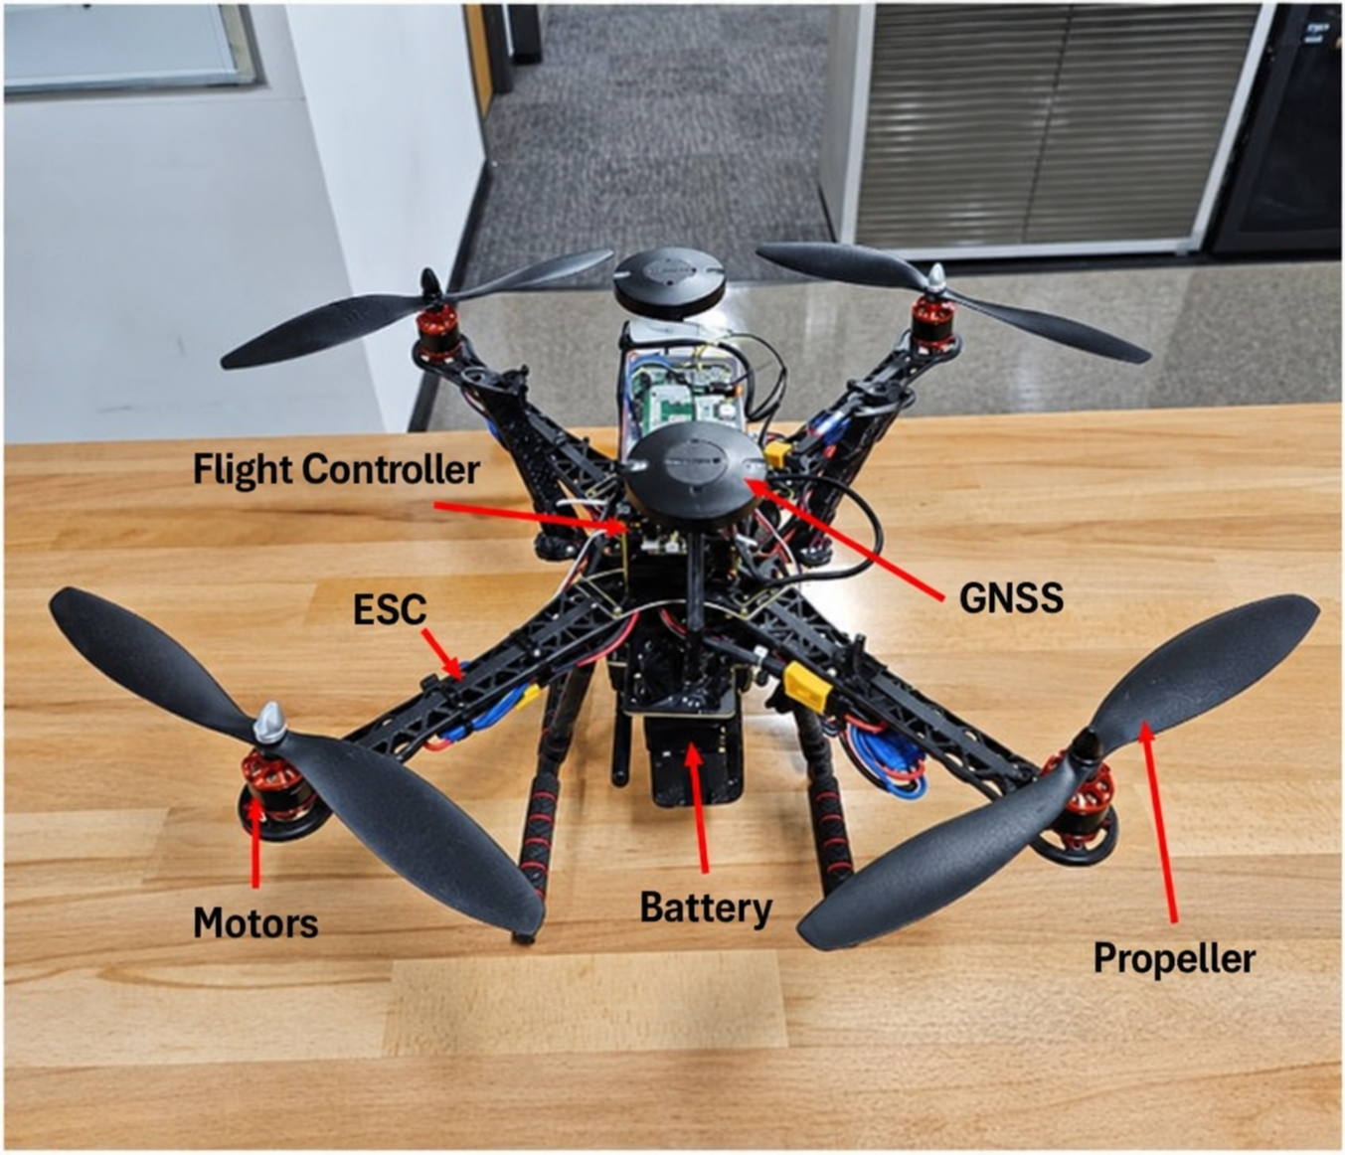
  Problem Statement
TEAM NAVDRISHTI
Design and Development of an Indigenous GNSS-Integrated Intelligent Flight Control System using ARIES v3, IMU and an Autonomous Flight Controller
1. External Dependency
Dependence on externally developed flight-control technology can limit control over customisation and supply chains.
2. Indigenous Capability
Build local expertise in embedded systems and indigenous processor-based flight control.
3. Technical Challenge
Integrate sensor processing, state estimation, control algorithms and motor outputs in real time.
4. Our Challenge
Develop and validate an autopilot using the prescribed ARIES v3 / VEGA platform.

Slide 4
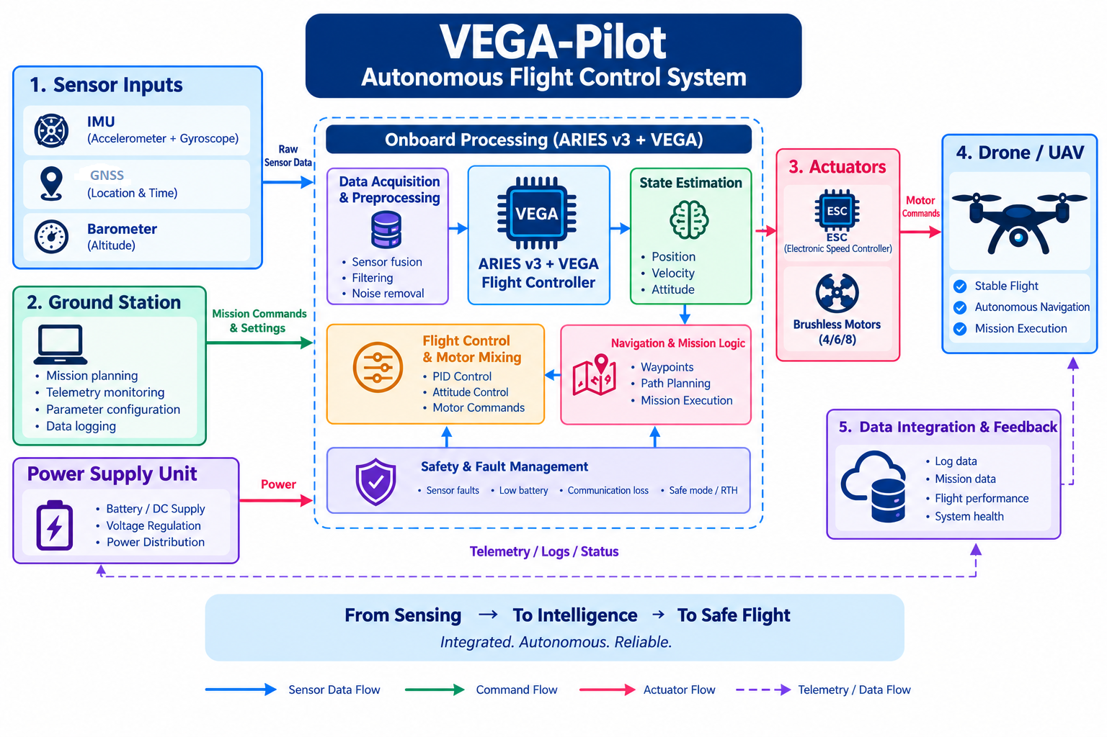
  System Architecture
TEAM NAVDRISHTI

Slide 5
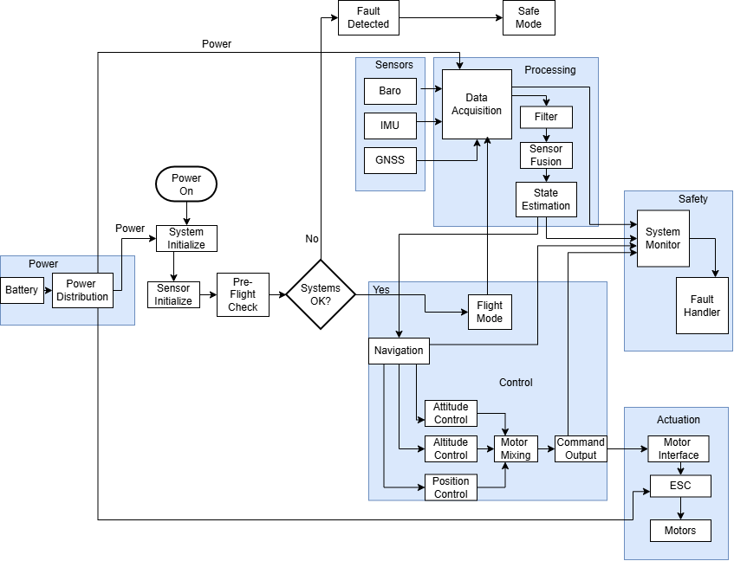
  System Working Flow
TEAM NAVDRISHTI

Slide 6
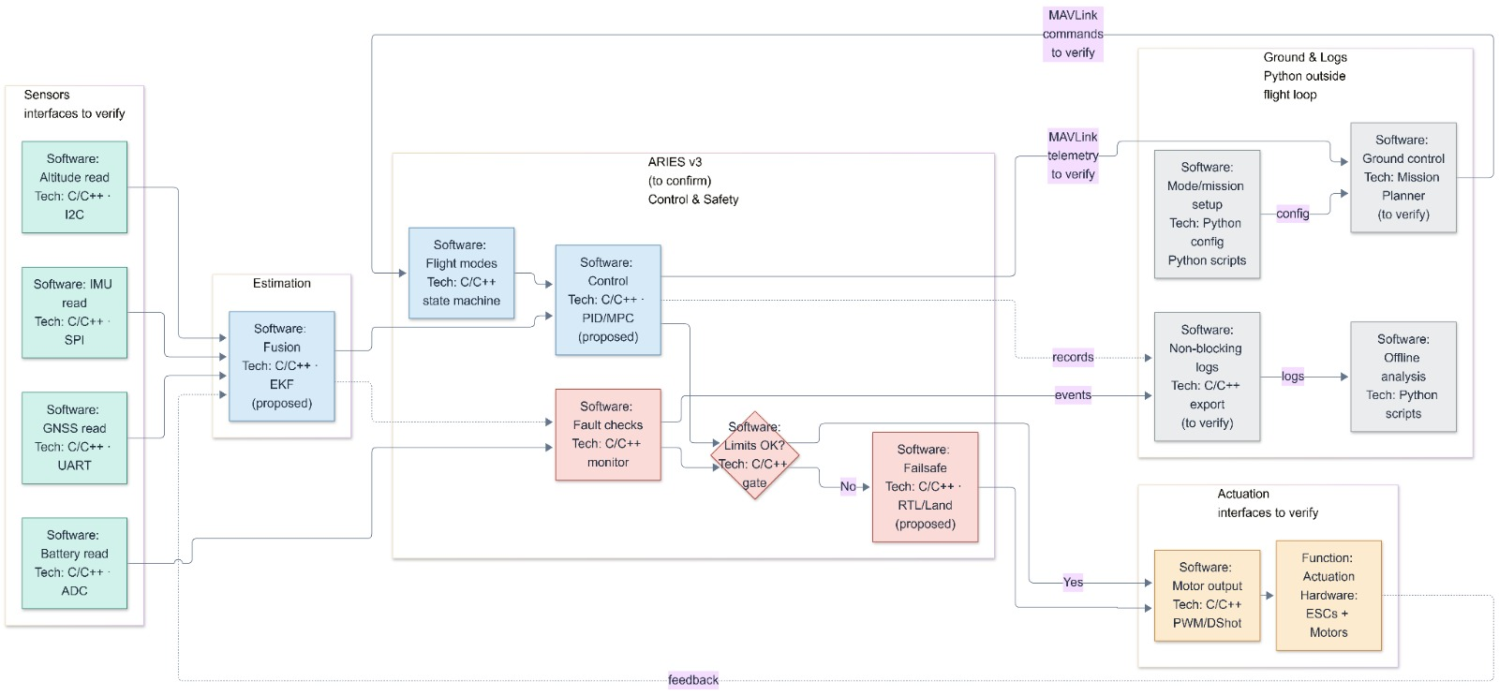
  Software Architecture
TEAM NAVDRISHTI

Slide 7
  PROGRESS SINCE PREVIOUS ROUND
TEAM NAVDRISHTI
Dashboard Prototype
Developed a monitoring dashboard using simulated flight data.
Prepared visualization of flight parameters and system status.
Fault Detection & Recovery
Designed a structured fault-detection workflow.
Defined proposed safety checks and fault-response decisions
Software Development Planning
Identified programming tools, communication methods, and required libraries.
Planned the integration of sensors, telemetry, and onboard processing.
Hardware Status
ARIES V3 board is currently in transit.
Hardware interfacing and testing are pending delivery.

Slide 8






  Software Stack & Libraries
TEAM NAVDRISHTI
Arduino IDE + VEGA Board Package
Embedded firmware development for ARIES V3.
Sensor interfacing and peripheral testing.
Python
Simulated telemetry generation and data processing.
Fault monitoring and dashboard integration.
PySerial
Enables serial communication between the laptop and the wireless telemetry receiver.
Streamlit / Dashboard Framework
Live parameter visualization.
System status and warning display.
Plotly
Visualizes live data, including battery voltage and altitude trends.
MAVLink
Enables standardized telemetry and supported command exchange with a compatible autopilot.

Slide 9
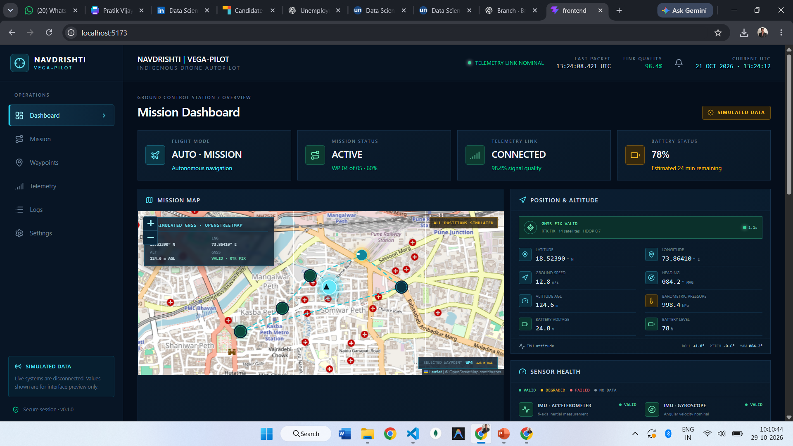
  GCS Dashboard
TEAM NAVDRISHTI

Slide 10
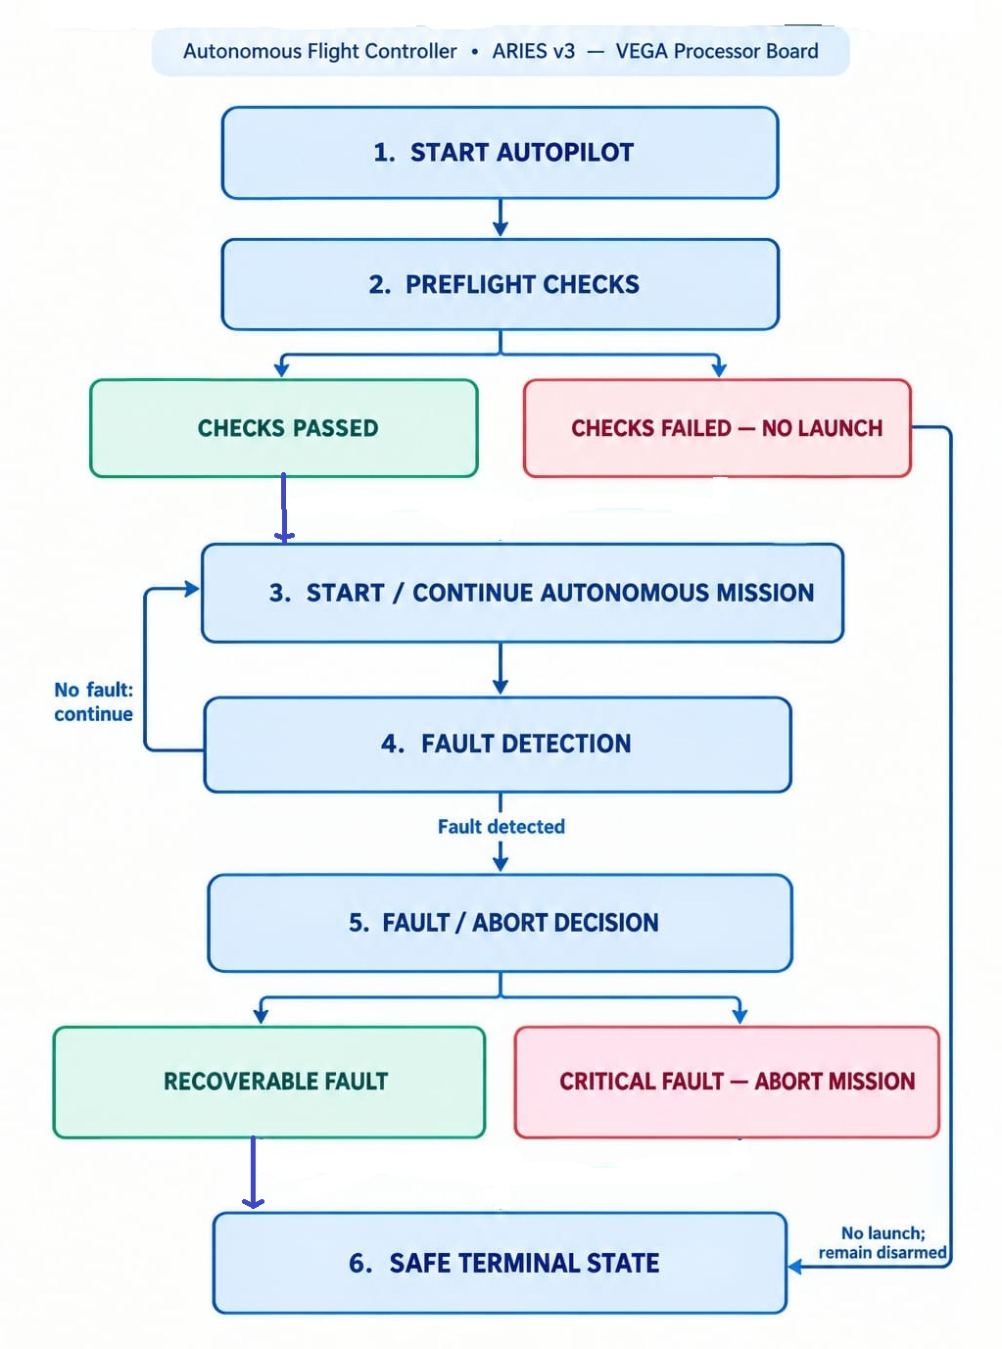
  Fault Detection and Recovery
TEAM NAVDRISHTI
Key Safety Measures
Pre-flight Safety
The drone will not launch if critical pre-flight checks fail.
Continuous Monitoring
Sensors, battery and telemetry are monitored during the mission.
Fault-Based Decisions
Recoverable faults trigger corrective action; critical faults trigger a suitable failsafe.
Safe Termination
The mission is aborted when necessary, and the drone follows its configured safe response.

